Slide 1
Homework Assignment 3
Digital Image Processing
Fall 2023
Deadline: 09:00 AM, Monday, 11/6/2023

Slide 2
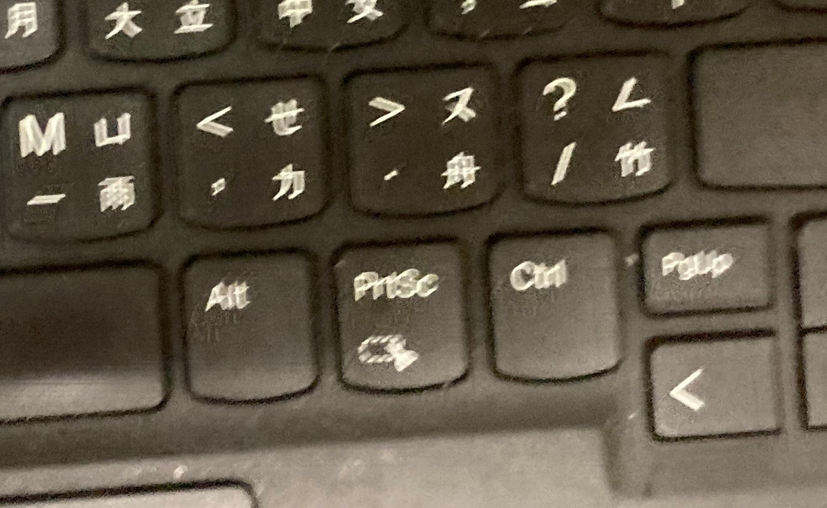
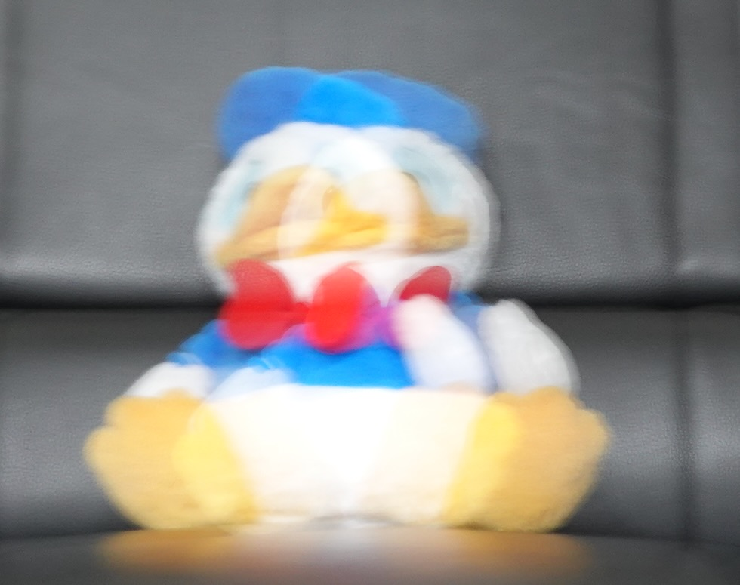
Problem 1 (50 points)
The image “motion blur_1_3024x4032.jpg” is corrupted by motion blur, as illustrated in the left figure. We do not have any information of the motion. From the figure, however, you can tell that different parts of the keyboard seem to have different degrees of blur, perhaps because the camera used to capture the image is at a slant angle with respect to the keyboard. You are asked to restore the image by all means and apply the same method to the toy image on the right, “Donald_Duck.jpeg.” Your score will be based on the final quality of your restored images.
motion blur_1_3024x4032.jpg
Donald_Duck.jpeg

Slide 3
Software Package Allowed
Python 3.8+
Standard Python library
Numpy 1.21.1
Opencv-python 4.5.1
Matplotlib 3.6.0

Slide 4
Assignment Requirements
All functions in the Software Package are allowed.
Set your directory structure as follows (otherwise -5 points):
r129XXXXX/
- p1.py
- report.pdf
- images/
- motion blur_1_3024x4032.jpg, Donald_Duck.jpeg
- Images of program output (Please use concise and clear file names for the images.)

Slide 5
Assignment Submission Requirements
Submit to NTU COOL
Deadline: 09:00 AM, Monday, 11/6/2023
Do NOT copy homework (code, report, results, etc.) from others

